Slide 1


Community Care VA Online Scheduling (VAOS CC) and Scheduling Manager (SM) Training
09/01/2020

Slide 2
Agenda
VAOS Overview
VAOS National Deployment
Veteran Eligibility
Impact for Veterans and facility community care staff
VAOS/SM Process Flow
VAOS CC and SM process and demonstration
VAOS CC and SM Resources
Notes:
Hello, everyone. Again, we would like to welcome you to today’s CC VA Online Scheduling training.
I’m Shaterri Brown from Community Care Clinical Integration. There are also a few other members of our VAOS team that will be assisting with today’s training. I am going to provide an overview of the Community Care VA Online Scheduling app ..of which you will hear referred to as VAOS (which is the veteran’s facing app) and Scheduling Manager which you will hear referred to as SM) (which is the staff facing app).
In today’s training we will discuss:
-The National Deployment Scheduled and what is required of each facility to enable Community Care VAOS at their site
-What are the impacts to the Veteran and community care staff, which are known as Resource Managers
-We’ll show screen shots of both the VA Online Application as well as Scheduling Manager. A recorded demonstration of both of these applications have been uploaded to Chapter 3.19 of the Field Guidebook.
-Lastly, we’ll review some frequently asked questions and answers and provide you will a few resources to get you started on your VAOS journey.

Slide 3

Overview
VA Online Scheduling (VAOS) enhances the MISSION Act access for Veterans who meet one of the required eligibility requirements
Community Care Request Managers begin processing Veterans requests submitted through VAOS.
National Deployment started November 30, 2018, at 71 VA Medical Centers (VAMCs) where VA staff schedules community care appointments on Veterans behalf.
A 10N memo was released requiring all participating facilities to be processing VAOS community care requests NLT August 17, 2020.
Remaining sites will implement VAOS by end of FY2020.
Eligible Veterans may request the following community care services via VA Online Scheduling:
Audiology – routine exam
Audiology – hearing aid support
Nutrition
Optometry – routine exam
Podiatry – routine exam
Primary care – routine appointment
Notes:
VA Online scheduling enhances the Mission Act access for Veterans who meet one of the required eligibility requirements. To access VA Online Scheduling, Veterans can visit www.myhealth.va.gov. and log in using their My HealtheVet, DS.Logon, or ID.me credentials. If the Veteran doesn’t have any of the following credentials, he or she would need to sign up for one of them.
The types of Community Care requests that can be requested are:
Audiology Routine Exams
Audiology Hearing Aid Support
Nutrition
Optometry routine exam
Podiatry routine exam
And Primary Care routine Appointment
Initially, National Deployment for Community Care VAOS started back in November 30, 2018 at 71 VA Medical Centers. Earlier this year, this feature was paused due to the unforeseen circumstances of COVID 19.
Now, the Office of Community Care is ready to reactive Community Care VAOS at those sites and implement Community Care VAOS to all other facilities.
On August 17th, the initial 71 facilities that previously used Community Care VAOS began processing requests and all other facilities will initiate Community Care for VAOS by the end of the fiscal year. The next two slides will provide outline the deployment scheduled

Slide 4
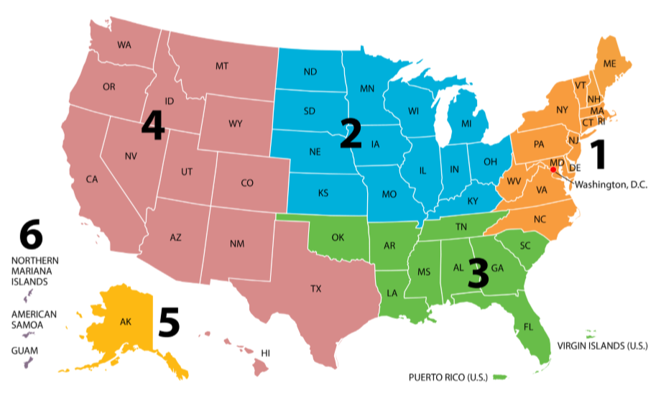
VAOS Participating Sites
August 17, 2020
VISN 1
VISN 4
VISN 10
VISN 7
VISN 19
Togus (402)
White River Junction (405)
Bedford (518)
Jamaica Plain (523)
Manchester (608)
Leeds (631)
Providence (650)
West Haven (689)
Wilmington (460)
Altoona (503)
Butler (529)
Coatesville (542)
Erie (562)
Lebanon (595)
Philadelphia (642)
Pittsburgh (646)
Wilkes-Barre (693)
Ann Arbor (506)
Battle Creek (515)
Chillicothe (538)
Cleveland (541)
Dayton (552)
Indianapolis (583)
Saginaw (655)
Columbus (757)
Augusta (509)
Birmingham (521)
Charleston (534)
Columbia (544)
Dublin (557)
Tuscaloosa (679)
Fort Harrison (436)
Sheridan (666)
VISN 20
Anchorage (463)
VISN 8
VISN 5
VISN 12
Bay Pines (516)
Miami (546)
West Palm (548)
Gainesville (573)
San Juan (672)
Tampa (673)
Orlando- Lake Nona (675)
VISN 2
Beckley (517)
Clarksburg (540)
Martinsburg (613)
Chicago (537)
Danville (550)
Hines (578)
Iron Mountain (585)
Madison (607)
Tomah (676)
Milwaukee (695)
Bronx (526)
Buffalo (528)
Canandaigua (528A5)
Bath (528A6)
Syracuse (528A7)
Albany (528A8)
East Orange (561)
Montrose (620)
Manhattan (630)
Northport (632)
VISN 6
Salem (658)
Salisbury (659)
VISN 23
Fargo (437)
Sioux Falls (438)
Fort Meade (568)
Minneapolis (618)
Omaha (636)
Des Moines (636A6)
Iowa City (636A8)
St. Cloud (656)
Notes:
As noted in the previous slide, the 71 facilities that used Community Care VA Online Scheduled were reactivated on August 17th. All sites are listed here.

Slide 5

Remaining Sites – Deployment Order
August 31st
September 14th
VISN 5
VISN 9
VISN 7
VISN 17
VISN 21
Baltimore (512)
Huntington (581)
Washington 688)
Lexington- Leestown (596)
Louisville (603)
Atlanta- Decatur (508)
Montgomery (619)
Amarillo (504)
Big Spring (519)
Dallas (549)
San Antonio (671)
Temple (674)
Harlingen (740)
El Paso (756)
Honolulu (459)
Fresno (570)
Las Vegas (593)
Sacramento (612A4)
Palo Alto (640)
Reno (654)
San Francisco (662)
VISN 10
VISN 9
Cincinnati (539)
Detroit(553)
Marion- Indiana (610)
Memphis (614)
Mountain Home (621)
Nashville (626)
VISN 6
VISN 12
VISN 19
VISN 22
Durham (558)
Fayetteville-NC (565)
Hampton (590)
Asheville (637)
Richmond (652)
Region 1 – 9 sites remaining
Alexandria- Pineville (502)
Biloxi (520)
Fayetteville- AR (564)
Houston (580)
Jackson (586)
Little Rock (598)
New Orleans (629)
Shreveport (667)
Fort Harrison (436)
Cheyenne (442)
Denver (554)
Grand Junction (575)
Salt Lake City (660)
Sheridan (666)
Albuquerque (501)
Long Beach (600)
Loma Linda (605)
Phoenix (644)
Prescott (649)
San Diego (664)
Tucson (678)
West Los Angeles (691)
Region 4 – 35 sites remaining
North Chicago (556)
VISN 15
Kansas City (589)
Columbia (589A4)
Topeka (589A5)
Wichita (589A7)
St. Louis (657)
Poplar Bluff (657A4)
Marion- Illinois (657A5)
Region 2 – 13 sites remaining
VISN 20
VISN 19
Boise (531)
Portland (648)
Roseburg (653)
Seattle (663)
Walla Walla (687)
White City (692)
Muskogee (623)
Oklahoma City (635)
Region 3 – 15 sites remaining
Notes:
All facilities that are new to Community Care VA Online scheduling will begin processing request either August 31st or September 14th.

Slide 6
Deployment Readiness Steps
Field Support will work with each facility POC to review and update the Deployment and Implementation Tracker (DIT). The DIT provides steps needed to ensure business readiness and technical functionality to meet the mandate date.
A. All participating facilities must have their VistA community care clinics set up for:
Audiology
Nutrition
Optometry
Podiatry
Primary care
B. Community care staff (Request Managers) should have the following access credentials enabled in VistA:
OR CPRS GUI CHART
DVBA CAPRI GUI
MBAA SCHEDULING CALENDAR VIEW (optional)
Notes:
In order to prepare for readiness, your assigned Clinical Integration Field Assistant will work with each VISN POC to review and update the Deployment Implementation Tracker. The DIT provides instructions need to ensure business readiness and technical functionality to meet the mandated implementation dates. The 71 facilities that are reactivating VAOS will not need to complete the new DIT as they have already done so with the initial implementation. The DIT is specific to the facilities that are just now implementing Community Care for VAOS for the first time.
From the DIT, two of the required tasks for VAOS Implementation includes having the appropriate clinics set up in VISTA and ensuring staff have the proper credentials and keys enable tin VISTA for scheduling.
All facilities must have their VistA community care clinics set up for Audiology, nutrition, optometry, podiatry and primary care. In addition, Community Care Request Managers must have: OR CPRS CUI CHART, DVBA CAPRI GUI enabled in VISTA and MBAA SCHEDULING CALENDAR VIEW is optional.

Slide 7
Veteran Eligibility
To be eligible to use VA Online Scheduling to request community care appointments, you must meet one (1) of the MISSION Act criteria embedded in the VAOS application.
Live in one of the following states – North Dakota, South Dakota, Montana, Alaska, or Wyoming, due to low Veteran population density
Reside in a U.S. state or territory without a full-service VA Medical Center (Alaska, Hawaii, New Hampshire, and U.S. territories of Guam, American Samoa, Northern Mariana Islands, and the U.S. Virgin Islands)
Veterans who do not meet MISSION Act standards but have a “general best medical interest (BMI)” that allows them to obtain some or all their care in the community as opposed to a BMI that is for a specific episode of care.
Potential reasons for general best medical interest (hardship) include geographical challenges, environmental factors, a medical condition that impacts the ability to travel, or if a Veteran needs to travel to their nearest VA medical facility by air, boat or ferry.
Have an average drive time to a VA Medical Center (VAMC) of more than 30 minutes for primary care, or more than 60 minutes for audiology, nutrition, optometry, or podiatry care.
Notes:
In order to use Community Care for VA Online Scheduling , the Veteran must meet one of the following Mission Act criteria embedded in the VAOS application:
-Live in one of the following states-North Dakota, South Dakota, Montana, Alaska or Wyoming, due to low Veteran population density.
-Reside in a U.S. state or territory without a full-service VA Medical Center (Alaska, Hawaii, New Hampshire, and U.S. territories of Guam, American Samoa, Northern Mariana Islands, and the U.S. Virgin Islands)
-If the Veteran does not meet access standards but has a General Best Medical Interest that allows a Veteran to obtain some or all of their care in the community as opposed to a BMI which is just for a specific episode of care
-Potential reasons for general best medical interests (hardship) include geographical challenges, environmental factors, a medical condition that impacts the ability to travel, or if a Veteran needs to travel to their nearest VA Medical Center by air, boat or ferry.
-If you have an average drive time of more than 30 minutes for primary care, or more than 60 minutes for audiology, nutrition, optometry, or podiatry care to a VA medical facility.

Slide 8
Veteran Community Care Requirements for VAOS
In order to submit a community care request thru VAOS, the Veteran must meet all the following system requirements:
The veteran must be eligible for Community Care based on static Veteran Community Care eligibility codes (VCEs) **AND**
This interface checks the Eligibility and Enrollment system for the static code check. If the response is 'not eligible’, the system will perform the drive time eligibility check via another authoritative data source.
The veteran must be registered at the target site **AND**
The target site must be enabled as a ‘Community Care VAOS site’ in the VA Toolset
*Note: this setting enables the Request Manager to view and process VAOS-submitted CC requests in Scheduling Manager.
Notes:
In order to submit a community care request through VAOS, the Veteran must meet all of the following system requirements.
The requirements are as follows:
-The Veteran must be eligible for Community Care based on static code or drive time.
This interface checks the Eligibility and Enrollment system for static codes. If the response is 'not eligible’, the system will perform the drive time check via another authoritative data source.
And
The Veteran must be registered at the target site and
The target site must be enabled as a Community Care VAOS site in the VA Toolset.
If the Veteran does not meet the system requirements, they will only have the option to request a community care appointment.
Note: This setting enables the Request Manager to View and process VAOS submitted community care requests.

Slide 9
What is new for the Community Care Staff?
Community care staff (Request Managers) workflow:
VAOS CC requests are automatically accessible in SM. Request Managers can see Veteran’s preferences (date, time, location, provider, etc.) in SM.
Must initiate processing VAOS CC requests within three (3) business days from submission date.
No need to confirm Veteran’s eligibility:
VAOS is integrated with the Enrollment and Eligibility System.
Only eligible Veterans may request community care appointments through VAOS.
VAOS automatically receives the Veteran’s eligibility status in the background.
Request managers will continue to:
Ensure Direct Scheduling and/or Primary Care Administrative consults using Computerized Patient Record System (CPRS).
Contact the Veteran to ask sorting questions for Audiology, Podiatry, Nutrition and Optometry.
Schedule appointments in Scheduling Manager (SM) and HealthShare Referral Manager (HSRM).
Notes:
of. First, once a Veteran makes a community care request through VAOS, you will receive that request through Scheduling Manager automatically. You will be able to see the Veteran’s preferences to include: proposed date and time for appointment, location of the appointment, specific provider (if known) just to name a few.
Request Managers must initiate processing Community Care VAOS request within 3 business days of submission date. The Request Manager will need to access Scheduling Manager at least once daily to search for new and updated community care requests.
Next, Veteran eligibility is checked using background logic. Only eligible Veteran’s will receive the option of requesting a Community Care Appointment.
Once you have received your community care VAOS request and are ready to move forward with processing the request, please ensure you are using the Direct Scheduling Consults and/or Primary Care Administrative Consult. Facilities will follow the current processes to enter a Direct scheduling consult or Primary Care Admin Consult. For example: If A veteran places a request for a routine Optometry Exam. The Request Manager would contact the veteran to obtain responses to the required sorting questions. If the veteran answers YES to any of the sorting questions a clinical entity would be required to further evaluate the veteran as the request may not be routine. At that time, the Community Care VAOS request would have to be canceled.
If the Veteran answers no to all the sorting questions, you may proceeding with completing your consult and scheduling the Veteran’s appointment.
Now, it’s time to scheduled your appointment. After you have spoken with the community provider and confirmed an appointment date and time for the appointment, you’ll need to add that appointment information in Scheduling Manager and HealthShare Referral Manager as Scheduling Manager does not write back to HealthShare Referral Manager.

Slide 10

What changed for the Veteran?
VAOS will automatically verify Veteran eligibility to request community care appointments.
Reduces the need to call the VA to request some community care services.
CC VAOS benefits:
Improves access to community care services.
Increases convenience.
Enhances customer experience.
Reduces wait times for community care appointments.
Notes:
A few things have changed for the Veteran in relation to Community Care for VAOS. As we have discussed in previous slides, eligibility for Community Care will be determined in the background and Veterans will only see the Community Care option if they meet previously mentioned community care eligibility criteria and specific VAOS system requirements.
In addition, Instead of the Veteran waiting on in a que to speak with a representative, they can directly request their community care appointment through VAOS. The benefits of this online route includes, improves access to select community care services, increases conveniences, enhances customer experience, and reduces wait for appointment requests.

Slide 11
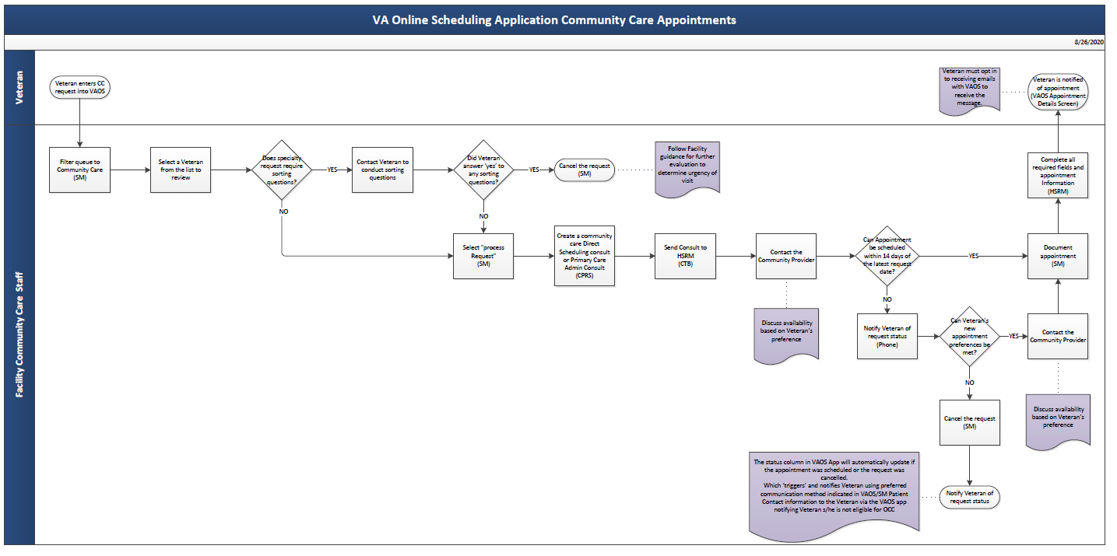
CC VAOS and SM Process Flow
Notes:
Here you will see a high level overview of the steps a Request Managers would follow once they received a community care request through VAOS.
(read flow map)
For today’s training, we will review the steps a request manger would take to create an appointment in Scheduled Manager once they have received a Community Care Request through VA Online Scheduling system.

Slide 12

Entering Community Care Request in VAOS (Veteran)
Notes:
In this portion of the training will we walk through how a Veteran enters a Community Care Request through VA Online Scheduling. I will turn it over to Debra, who will act as the Veteran entering a community care request for Optometry.

Slide 13
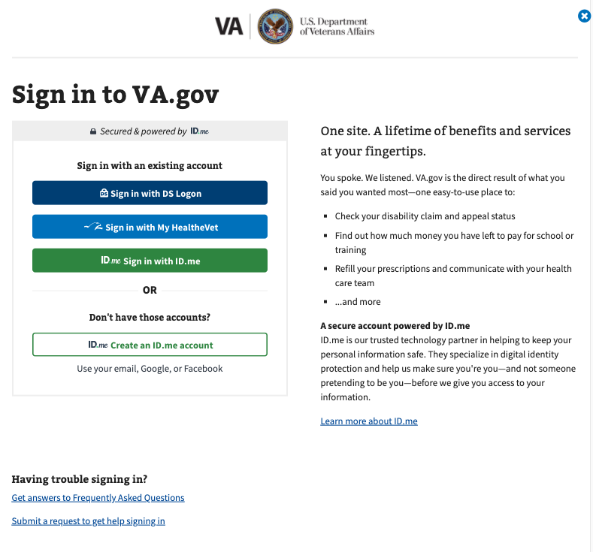
Accessing VA Online Scheduling
VA Online Scheduling accesses Veteran’s VA Electronic Health Record (EHR) and therefore, for their security, requires the Veteran to login using a My HealtheVet Premium Account, id.me account, or a DS Logon Level 2 (Premium) Account.
Notes:
VA Online Scheduling accesses Veteran’s VA Electronic Health Record (EHR) and therefore, for their security, requires the Veteran to log in using a My HeatheVet Premium Account, id.me account, or a DS Logon Level 2 Premium Account. If the Veteran doesn’t have any of those account, he/she will need to create one

Slide 14
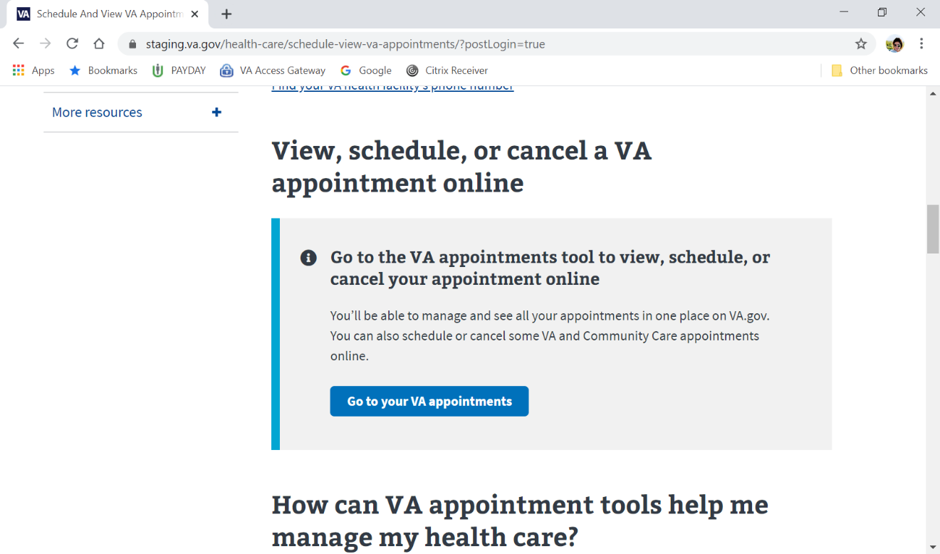
Initial Screen
In the first screen the Veteran will select Go to your VA appointments.
Once logged in, the Veteran will be able to view confirmed and past appointments and create a new appointment.
Notes:
In the first screen the Veteran will select “Go to your VA appointments”
Once the Veteran has logged in using the appropriate log-ins, the Veteran will select “VA Appointments”. In this tab, the Veteran will be able to view confirmed and past appointments and create a new appointment.

Slide 15
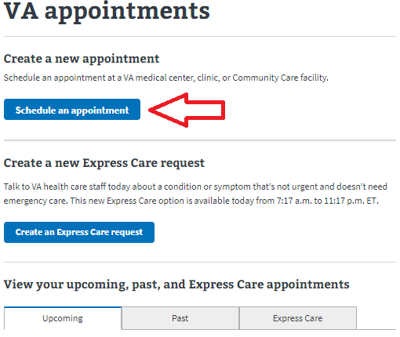
Request Appointment
On the VAOS VA Appointment screen, the Veteran will select Schedule an Appointment to submit request for VA or CC appointments.
Notes:
On the VOAS VA Appointment Screen, the Veteran will be able to select “Schedule an Appointment” to submit a request for VA or community Care Appointments.

Slide 16
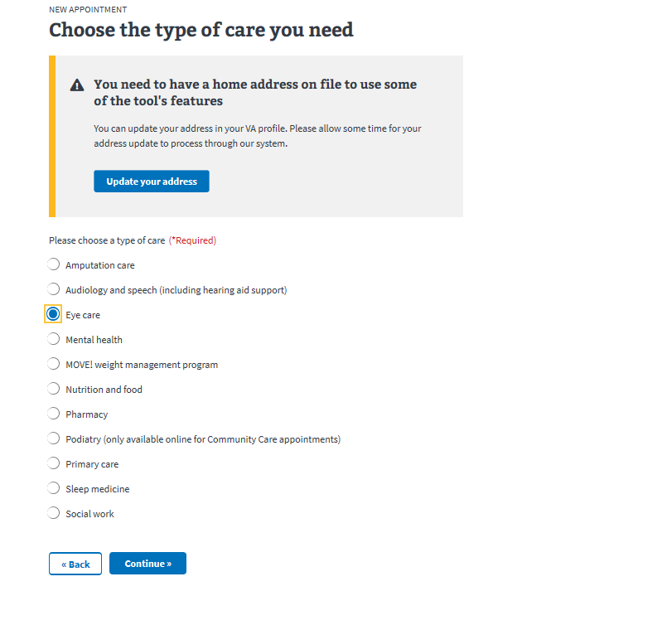
Selecting Type of Care
The veteran selects a Type of Care *.
Note: This list shown includes types of care offered by both VA and the community.
*Note: Only audiology, eye care, nutrition, podiatry and primary care are eligible for community care.
Notes:
Next, the Veteran will select the type of care desired. The list shown includes types of care offed by the VA and the community; however, only audiology, eye care (optometry), nutrition, podiatry, and primary care are eligible for Community Care.
The type of care selected will prompt VAOS to determine if the Veteran is eligible for Community Care.

Slide 17
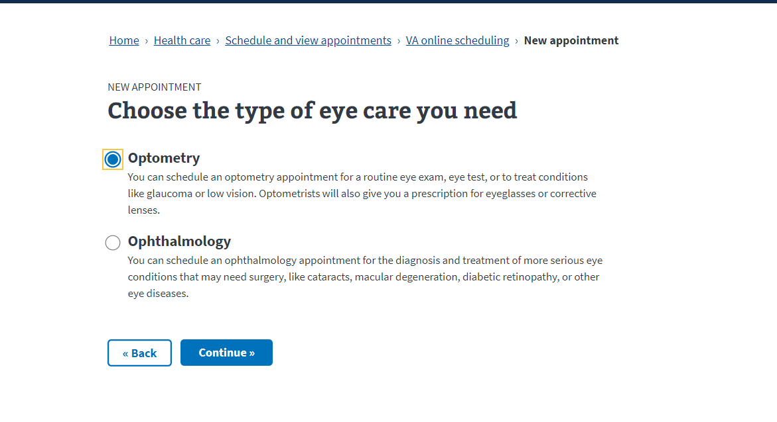
Type Care Selection – sorting window
When selecting Eye Care, VAOS will prompt the Veteran to select between Optometry and Ophthalmology.
Notes:
When selecting Eye Care, VAOS will prompt the Veteran to select between Optometry and Ophthalmology. Optometry is only available for Community care. If the Veteran chooses ophthalmology, they will be directed to the VA workflow.

Slide 18
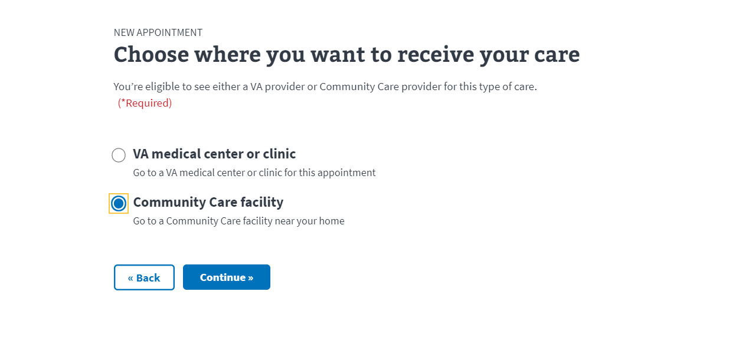
Community Care Appointment Requests
CC – eligible Veterans will be prompted to select between VA Medical Center facility or Community Care facility for appointment location.
Notes:
After the Veteran selects Optometry, they will be prompted to select between VA Medical facility or Community Care Facility for appointment locations.

Slide 19
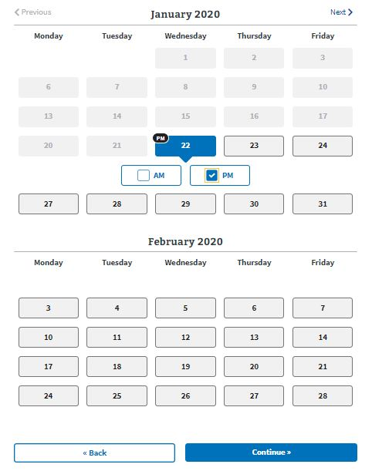
Appointment Date and Time Preferences
Veteran may select up to three (3) dates and times
Notes:
Once the Veteran has determined where they’d like to receive their care, they may select up to three dates and times that they are available for their optometry appointment

Slide 20
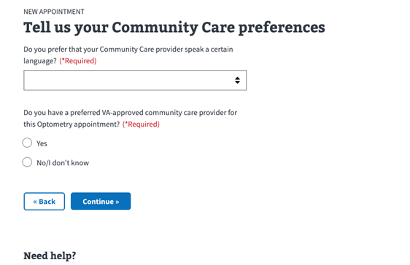
Community Care Preferences
Language preferences available
Veterans can currently only enter one (1) preferred provider
Notes:
The Veteran is also required to provide additional details on their community care preferences. The Veteran is required to select which language they want their provider to speak and if they have a preferred in-network community care provider they’d like to see for the Optometry appointment. Currently, Veterans are only able to input one preferred provider.

Slide 21
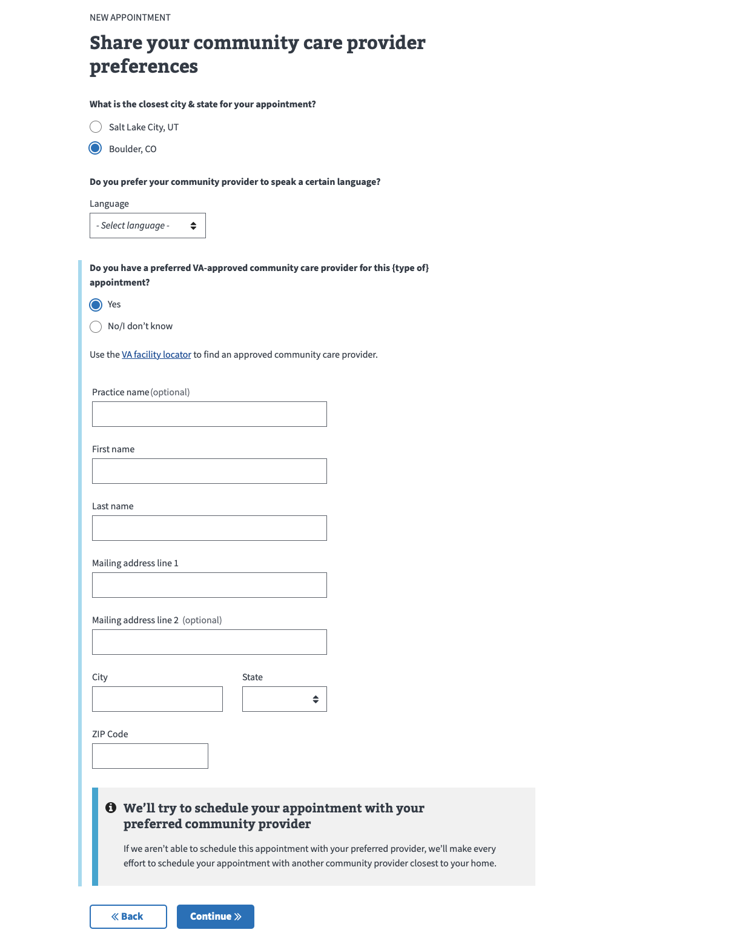
Preferred Provider Information
Veterans are required to provide all provider contact information when selecting preferred provider
Notes:
If the Veteran has a preferred provider they’d like to see, they are required to provide all provider contact information. The Veteran can use the VA Facility Locator tool as a reference to obtain provider demographic information for in-network providers.
https://www.va.gov/find-locations

Slide 22
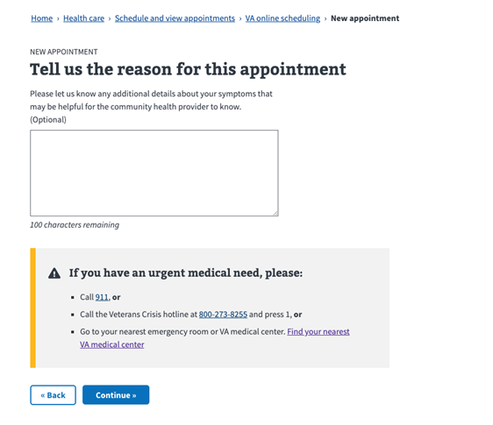
Appointment Reason
Veterans may provide additional information related to the request (this field is optional)
Veterans are prompted to seek care if they determine their need is urgent
Notes:
If there are additional details about the appointment that the Veteran wants the Request Manager to be informed of, they can include that information in the free text box. This is optional. In previous version of VAOS, there was a “Veteran’s Reason for Selection” radio dial option that was required. That question is no longer required and has been removed.
If the Veteran has an urgent need, they are instructed to seek care outside of the VAOS application by one of the following avenues: Calling 911, Contacting the Veterans Crisis Line, or reporting to the nearest emergency room or VA Medical Center.

Slide 23
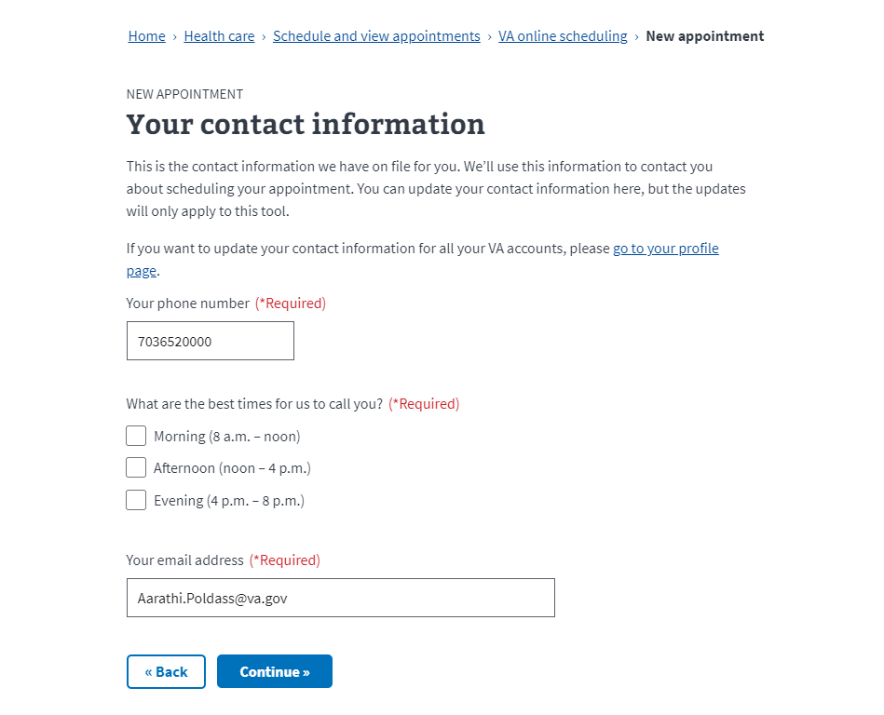
Veteran Contact Information
VAOS will automatically populate the contact information on file for the Veteran, but s/he can also enter new contact details that will only be for this request. They may select what are the best times to reach them.
Notes:
VAOS will pull up the contact information on file for the Veteran automatically, but the Veteran can enter new contact details. The updates will only apply to this request and to VAOS. Veterans should continue to follow current process for updating their contact and demographic information.
In addition, the Veteran will be required to select a timeframe when they can be contacted regarding their appointment.

Slide 24
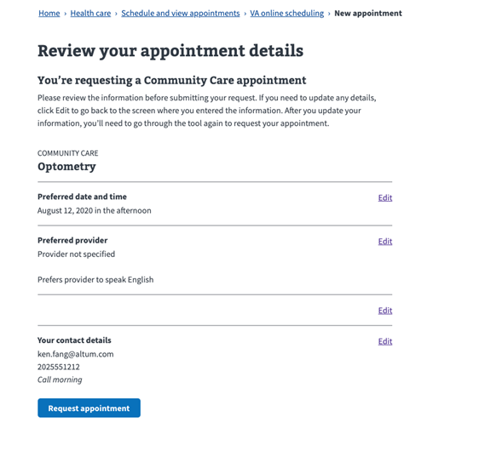
Review Request Details
After entering all the appointment request information, the Veteran can review the information before submitting ‘Request Appointment’.
Notes:
We are now in the home stretch of requesting a community care appointment. After the Veteran has gone through each screen and selected what type of care they want, where they want to have it , whom they want to provide the care, and provided their contact information, The Veteran will have the opportunity of reviewing that information before finalizing their appointment request.
If there are any changes needed, the Veteran can select the Edit button and make the adjustments at this time.

Slide 25
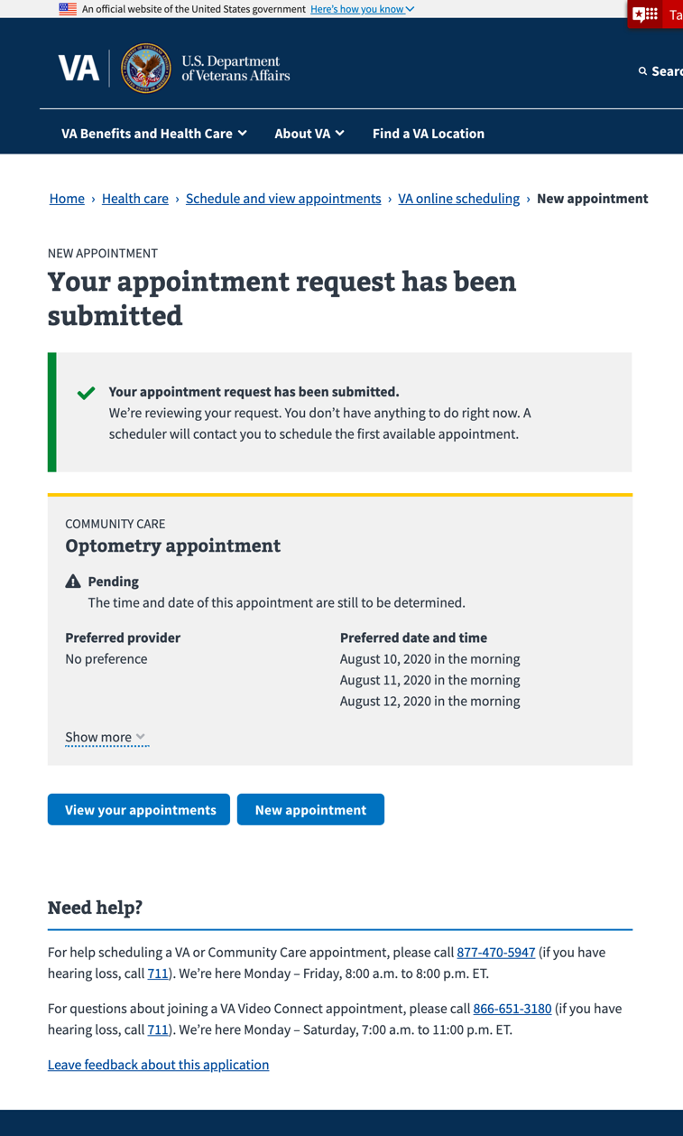
Community Care Request Submitted
Notice in the top left of the screen that the request has been submitted and will now be accessible in Scheduling Manager. The request details are listed.
Notes:
After the Veteran selects “Request an Appointment”, there will be a confirmation page with the request details. Notice in the top left of the screen that the request has been submitted and transmitted to Scheduling Manager. The request manager can now go into Scheduling Manager and look for this request in their scheduling que.

Slide 26
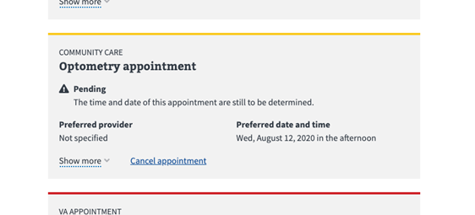
View Appointment Requests
Once the appointment request has been submitted, it will be displayed for the Veteran as a pending appointment (indicated by a top yellow border) in VAOS.
Notes:
Once the appointment request has been submitted to Scheduling Manager (SM), it will be displayed for the Veteran as a pending appointment (indicated by a top yellow border) in VA Online Scheduling.

Slide 27
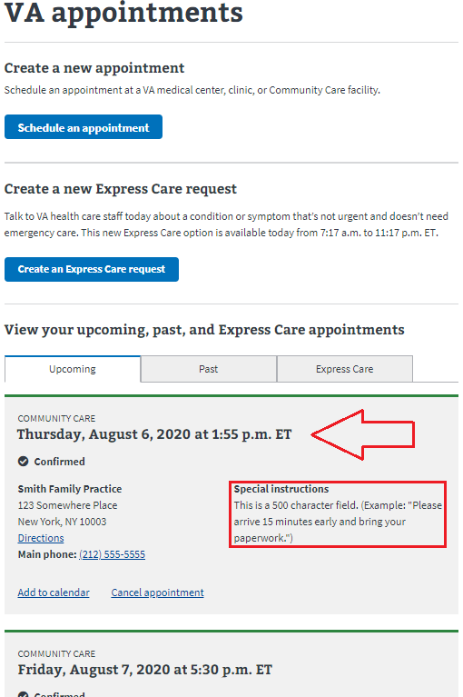
View Scheduled Appointments
When the request is processed (i.e. scheduled) in SM, the original request will be updated and displayed on the VAOS VA Appointment screen as a Confirmed appointment (now indicated by a green top border; any requests cancelled by either the Veteran in VAOS or the Request Manager in SM, would have a red top border).
Notes:
When the request is processed in scheduling manger, the original request will be updated and displayed on the VAOS VA appointment screen as a confirmed appointment, with a green top border. Any requests cancelled by the Veteran in VAOS or the Request Manger in Scheduling Manger, would have a red top border

Slide 28
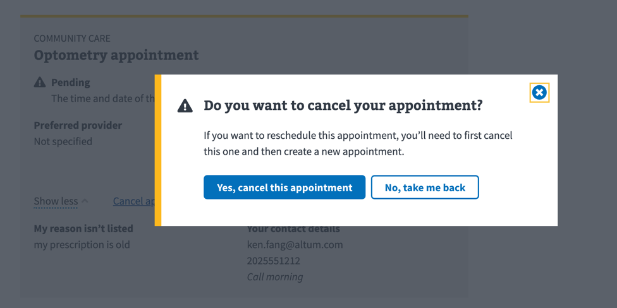
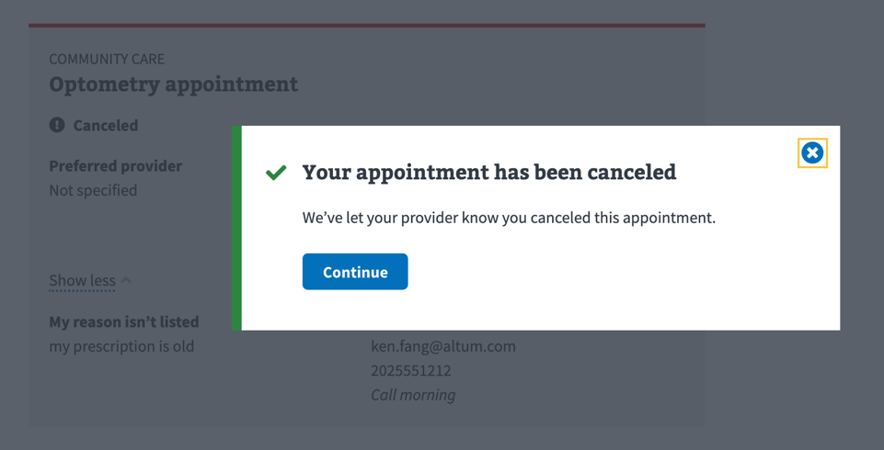
Request Cancellation Policies
Veterans may only cancel requests in the VAOS.
Notes:
If the Veteran decided he no longer wants/needs the requests, the Veteran can cancel the appointment request. Please note, Veterans may only cancel VOAS requests.

Slide 29
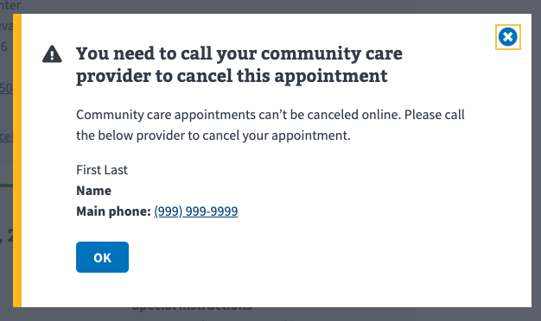
Cancelling Scheduled CC Appointment
Veterans must call the community care provider in order to cancel a scheduled appointment
VAOS will prompt the Veteran to call their provider
Notes:
Once the appointment has been scheduled and Jack decides he wishes to cancel the appointment, he will need to contact the provider directly. Scheduled appointments cannot be canceled in VAOS. Only appointment requests can be canceled in VAOS.

Slide 30
Scheduling Manager (SM) Processing a Community Care Request (Request Manager)
Notes:
We’ll now walk through out Scheduling Manager workflow.

Slide 31
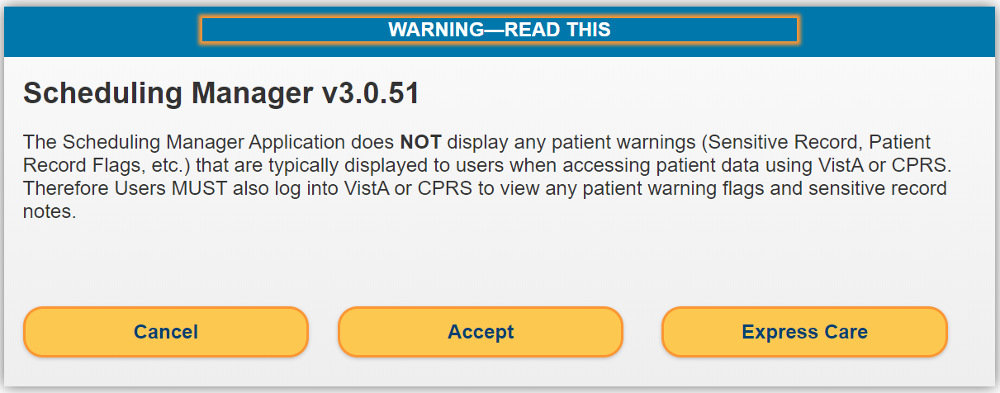
Scheduling Manager Log In Warning
The Veteran’s appointment request is processed using Scheduling Manager. When logging in, this warning message stating that the system does not display patient warnings appears. The Request Manager will select “Accept” to proceed.
Notes:
Once the Veteran has finalized and submitted their appointment request, the community Care Request Manager will be able to see their request in Scheduling Manager.
When logging into Scheduling Manger, the Request Manger will see a warning message stating that the system does not display patient warnings. The Request Manager will select “Accept” to proceed.

Slide 32
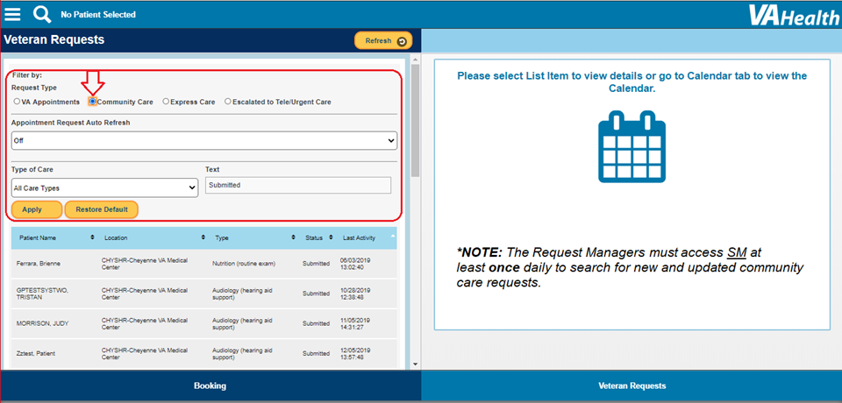
View Veteran CC Requests
Request Managers must access SM at least once daily to look for new and updated community care requests. Select the Community Care ‘Request Type’ to view CC appointment requests (left pane). To view the CC request, select one from the list on the left pane.
Notes:
Once you accept the warning message, the Request Manager will see a list of appointment request that have submitted through VAOS.
The Request Managers must select the Community Care option as the system automatically defaults to ‘VA Appointments’. Scheduling Manager then filters the list of requests, showing only community care requests. You will then be able to select your Veteran’s request.
The list includes the following information for each request: Veteran’s name, location, appointment request type, appointment request status (Submitted, Canceled, Scheduled in Community) and the date and time when the request was last acted upon.
The facility community care staff must access SM at least once daily to search for new and updated community care requests.

Slide 33
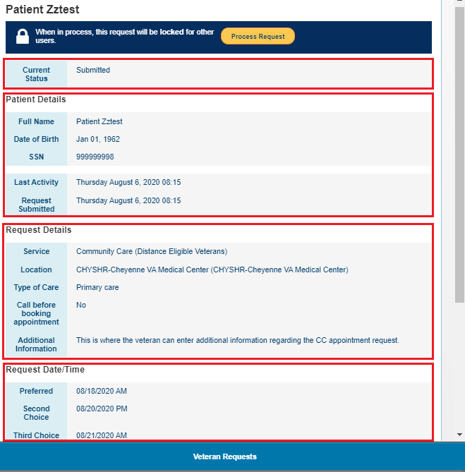
Request Details
Details that are shown in the Veteran Requests right pane include:
Current Status – current appointment status (e.g. Submitted, Cancelled, Scheduled in Community)
Patient Details - the Veteran’s full name, date of birth, Social Security Number, last activity and date when the appointment request was submitted.
Request Details - Requested service, clinic location, type of care, appointment reminder call preferences, and any additional information provided by the veteran.
Request Date/Time - the Veteran may select up to three preferred appointment dates and times (AM or PM).
Patient Contact – Phone number, best time to call, text capabilities, email address, and frequency of notifications.
Notes:
Once you have selected a Veteran from the list, or in our case, selected a particular Veteran, you will be able to see the details of the request once you click on it. Details that are shown in the Veteran’s request include:
-current request status, patient details, request details, request date and time, and patient contact information. All of these details will be pertinent for when we begin our scheduling efforts.

Slide 34
Sorting Questions
Contact the Veteran to ask sorting questions, if applicable.
If the Veteran Answers “Yes” to any of the sorting questions, the request must be canceled in Scheduling Manager. The Request Manager must follow local guidance and contact clinical staff to evaluate the Veteran further.
If the request doesn’t warrant sorting questions, the Request Manager would complete the consult and begin the scheduling process.
Notes:
Read Slide

Slide 35
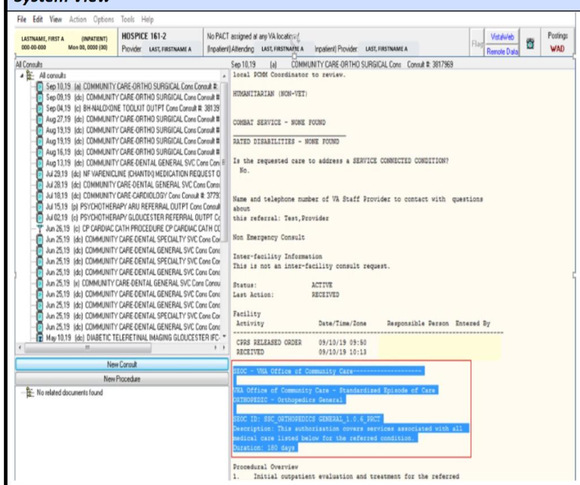
Create a Consult
Depending on the type of care being requested, the Request Manager would create a Direct Scheduling or Primary Care Administrative Consult for the Veteran in CPRS.
Direct Scheduling Community Care Consults do not need to be triaged by a clinician and can be used for the entire episode of care.
A Veteran can request these services, without needing a clinician to enter the consult, as Direct Scheduling consults are patient directed.
The Request Manager will complete the consult with pre-filled approved services (requirement to place name of VA Provider who will be responsible for all communication and oversight of the consult, pre-established SEOC timeframe and pre-filled Provisional Diagnosis (ICD-10 code).
Notes:
Read Slide

Slide 36
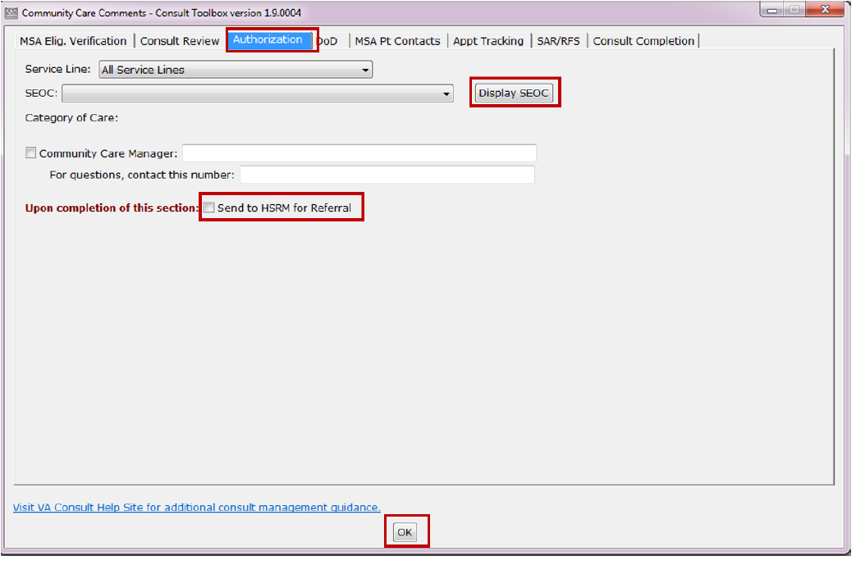
Consult Completion
Before proceeding with the scheduling process, the Request Manager will review the consult for completeness. This includes completing MSA Eligibility Verification Tab, ensuring the SEOC information has been added, and checking the box to send the consult to HSRM.
Afterwards, the Request manage is ready to begin the scheduling process.
Notes:
Read Slide

Slide 37
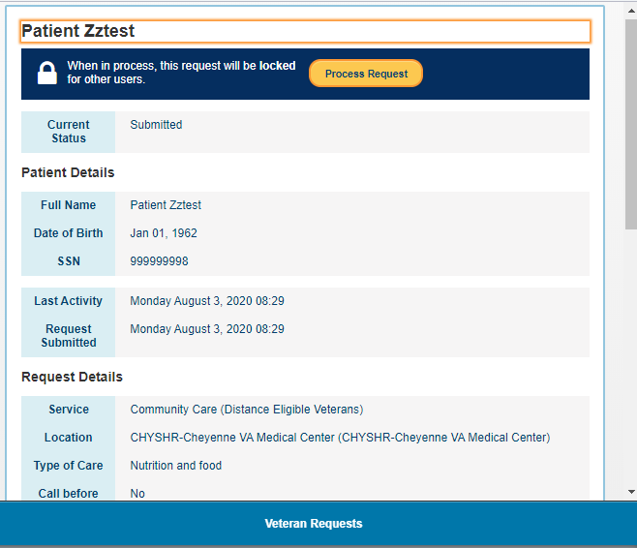
Selecting a Community Care Request for Processing
From here, the Request Manager will select Process Request.
Notes:
When the request is selected, the right pane of the screen displays information about the Community Care request.
If the selected request is already being processed, the “Process Request” button is grayed out. The request is “locked” and cannot be edited. The Request Manager would need to select a different request.
After you have reviewed the details of the request, you can proceed by selecting process request.

Slide 38
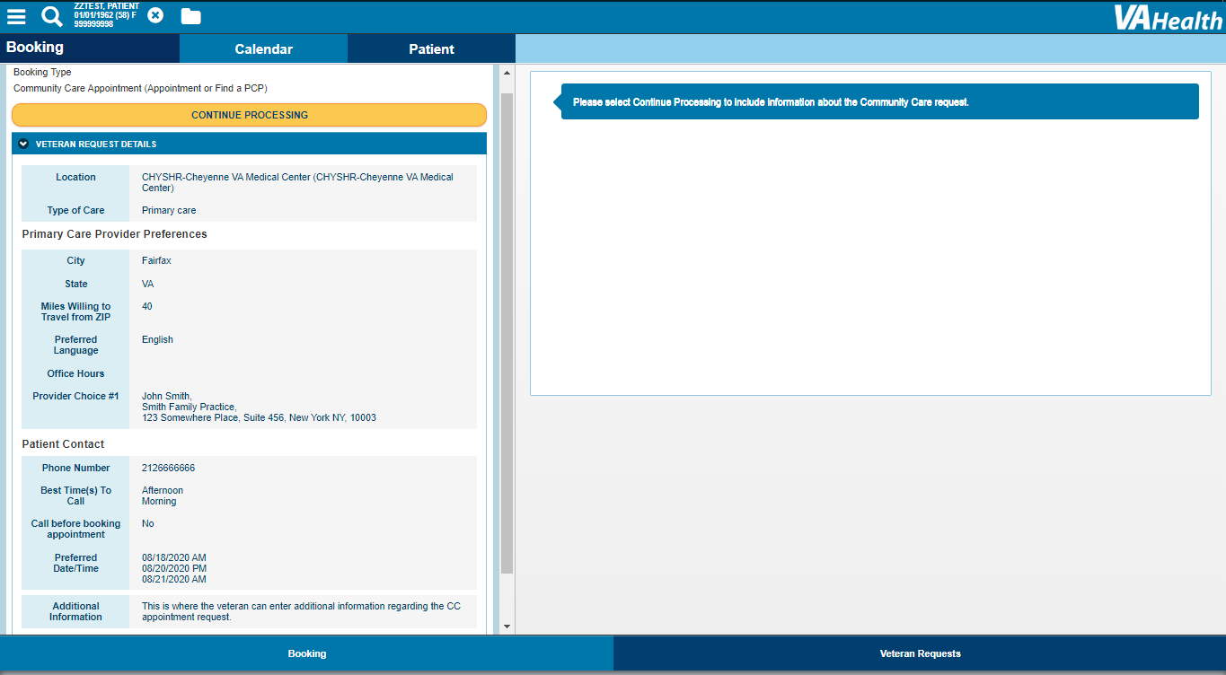
Booking Request
After selecting the Process Request option, the Request Manager is advanced to the Booking section of Scheduling Manager to continue processing the request.
Notes:
After selecting the process request option, the Request Manger will be advanced to the booking section of Scheduling Manger to continue process the request

Slide 39
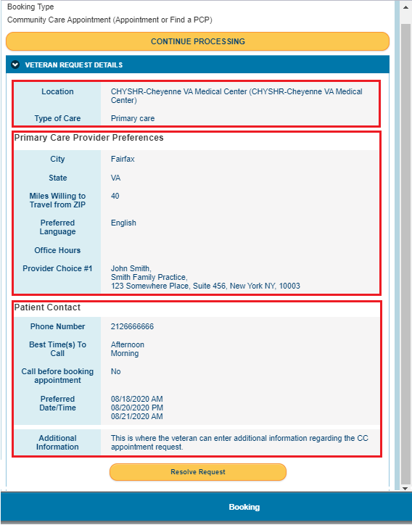
Resolve Request
A summary of the veteran’s request details appears in the left pane of the Booking section and includes:
Location and Type of Care
Primary Care Provider Preferences - City/state/ zip code of preferred clinic, miles the Veteran is willing to travel from his or her zip code to an appointment, preferred language, clinic office hours, and their choice(s) of any VA-approved community care provider(s).
Patient Contact - Veteran’s phone number and appointment reminder call preferences
From here, the Request Manager can select either to Continue Processing or Resolve Request from the left side of the screen.
Notes:
Within the Booking Section, the Request Manger will see further details of the Veteran’s scheduling preferences. The Booking Section includes the Location and Type of Care being requested, Community Care Provider Preference, and the patient’s contact information. From here, the Request Manger can select either Continue Processing or Resolve Request.
Selecting Continue Process will take you to the next screen to enter appointment details. While Resolving the Request will prompt you to cancel the request.

Slide 40
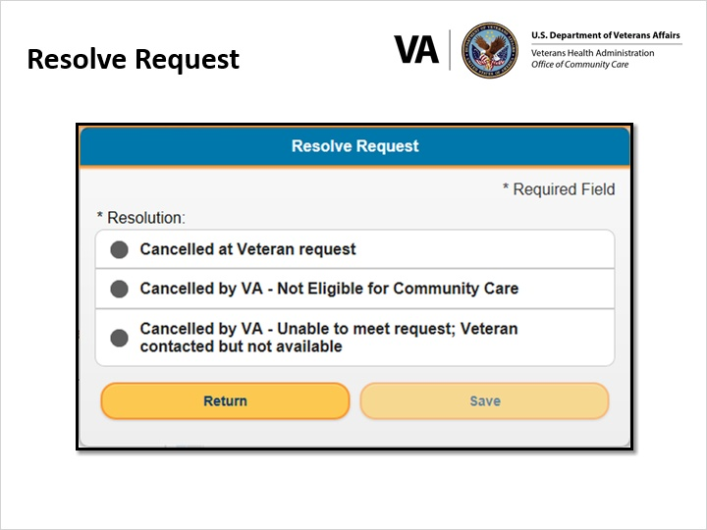
Resolve Request (to Cancel)
If Veteran answers Yes to any of the sorting questions, then ‘Cancelled by VA – Not Eligible for Community Care’ should be selected.
Notes:
If you selected to cancel the request, whether at the Veteran’s request or reasons identified after further review of the request, the Request Manger would cancel the request using one of the identified cancellation reason.
If the Veteran answers Yes to any of the sorting questions, the Request Manger should selected “Cancelled by VA-Not Eligible for Community Care’.

Slide 41
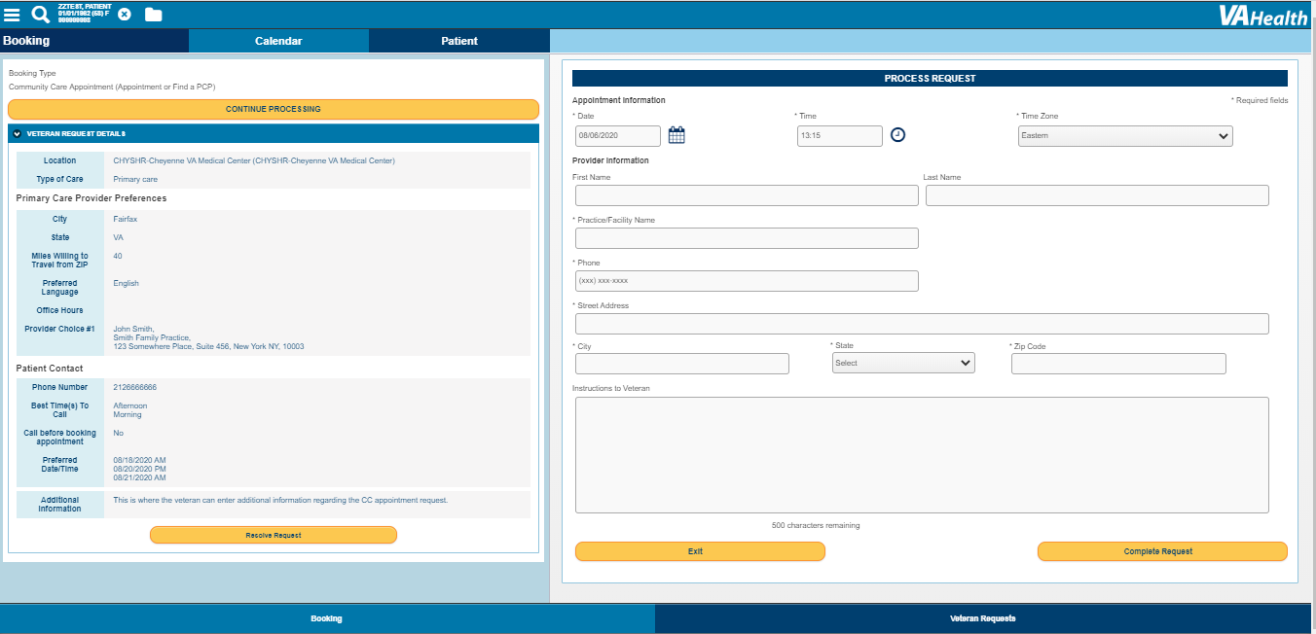
Resolve Request (to Schedule Appointment)
After selecting Continue Processing, the Request Manager will be asked to provide the appointment information.
Notes:
If the Request Manager chooses to proceed with processing the request, once they’ve selected Continue processing, they’ll be brough to a screen where they can enter appointment details.

Slide 42
Contact Provider
In our example, the Veteran’s scheduling preferences were already documented within VAOS. Given that we know this information, we can proceed with the scheduling process.
The Request Manger would contact the provider’s office to verify the provider’s availability for the dates and times specified by the Veteran.
If the Veteran’s preferences can be met, the Request manager can enter the appointment details into Scheduling Manager and create a HSRM referral to include the appointment details.
If the Veteran’s preferences cannot be met, the Request Manager would need to contact the Veteran to discuss new appointment dates and/or times.
Notes:
Read Slide

Slide 43
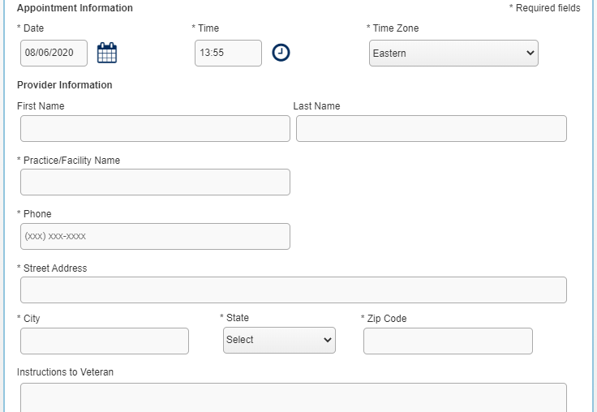
Resolve Request (to Schedule Appointment) Cont’d
The Request Manager should contact the community care provider to discuss availability and schedule the appointment based on the Veteran’s preferences.
*If possible, initiate a three-way call with the Veteran and provider to expedite the appointment coordination process.
Notes:
If the appointment can be scheduled within 14 business days of the last request date, the Request Manger should proceed with booking the appointment in Scheduling Manger. If the Veteran’s preferred provider is not available, the Request Manager can use the locator tool to locate a different provider.
If the Veteran cannot be reached or the Veteran’s preferences cannot be met, then proceed to “Cancel a Request” using the Resolve Request option button
After the Request Manager has performed all task necessary to confirm a Veteran’s appointment, they can begin filling out the appointment screen in Scheduling Manger.

Slide 44
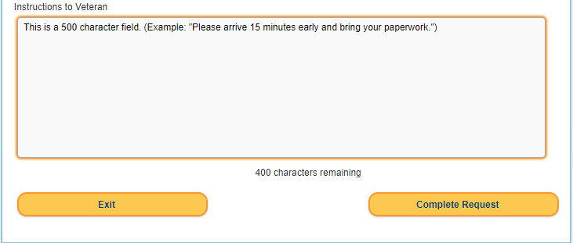
Veteran Instructions
The Request Manager should be sure to include any instructions for the Veteran. Once all the appointment information has been entered, the Request Manager will select “Complete Request”.
Notes:
When entering the appointment details in Scheduling Manger, the Request manger should ensure to include any instructions for the Veteran. Back and forth messaging between the Veteran and the Request Manger is no longer an available feature within Scheduling Manger. Once all the appointment information has been entered, the Request Manager will select Complete Request.

Slide 45
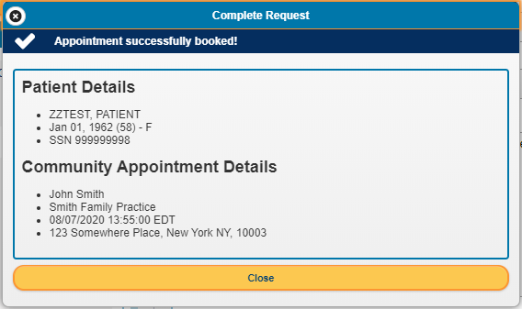
A confirmation window will appear verifying that the appointment has been successfully booked. The Request Manager will select “Close” to close the confirmation window.
Complete Request
Notes:
Once the request manager selects complete the request, a confirmation window will appear verifying that the appointment has successfully booked. The Request Manager will select close to close the confirmation window.

Slide 46
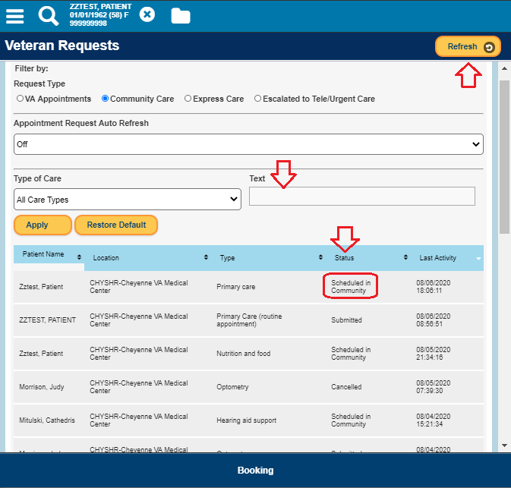
Appointment Status
By default, the Community Care queue always shows new requests in a Submitted status.
To see other statuses (e.g. Cancelled, Scheduled in Community) make sure the Text field is blank (always defaults to ‘Submitted’) and click on the Refresh button.
- Notice that the appointment now shows at the top of the list and the status is “Scheduled in Community.”
Notes:
Now that the Request Manager has successfully booked the optometry appointment, they have the ability to go back to their referral list and see that the status has changed.
By default, the Community Care queue always shows new requests in a Submitted status. To see other statuses such as Cancelled or Scheduled in Community, the Request Manager will need to make sure the Text field is blank and click on the Refresh button. Once the que is refreshed, you’ll notice that the appointment now shows at the top of the list and the status is “Scheduled in Community.”
The Request Manager has completed this request and can now move on any others they have within the que.

Slide 47
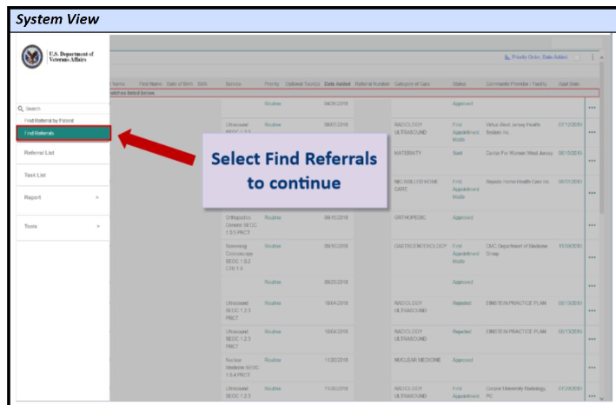
Completing the HSRM Referral
Once you have added the appointment details in Scheduling Manger, you will need complete the HSRM referral and add the appointment details there as well.
Log into HSRM and find the referral you sent over from CPRS using the Unique Consult ID number.
Notes:
The Request Manger will also need to complete the HSRM referral and enter the appointment information here as well. We’ll first start by logging into HSRM.

Slide 48
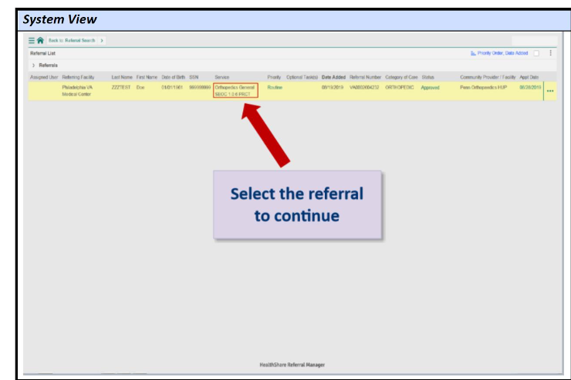
Verify that all the information is correct and select the referral.
Notes:
Read Slide

Slide 49
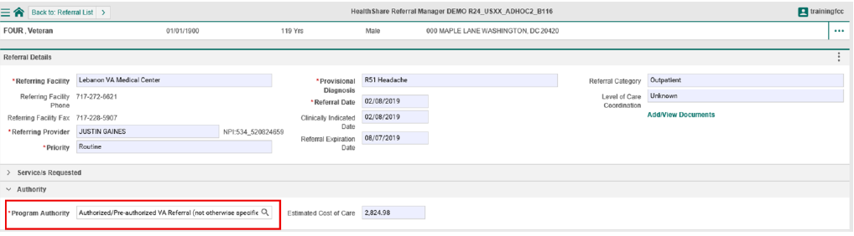
Once you have located your referral, you need to select the correct program authority
Notes:
Read Slide

Slide 50
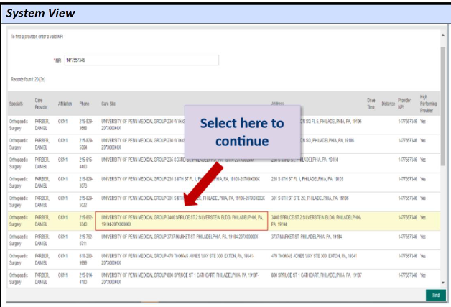
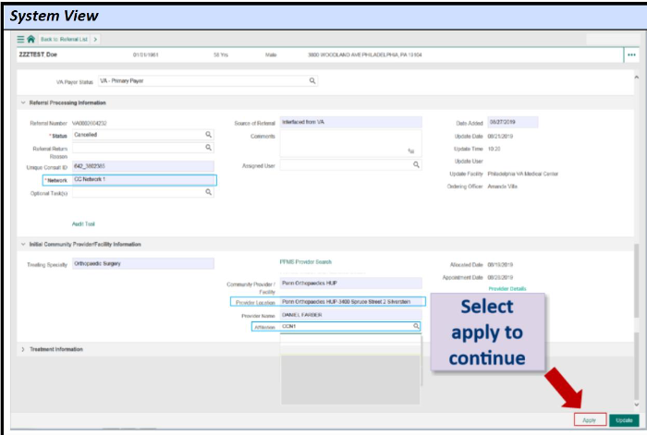
Next, you will enter the Veteran’s preferred provider’s NPI number. Select find and choose the appropriate provider from the search results.
On the Referral Details screen, the Community Provider/Facility, Provider Location, Treating Specialty, Affiliation, Provider Name, and Network fields will populate automatically once you select a provider.
Ensure to select Apply to save all updates you just made.
Notes:
Read Slide

Slide 51
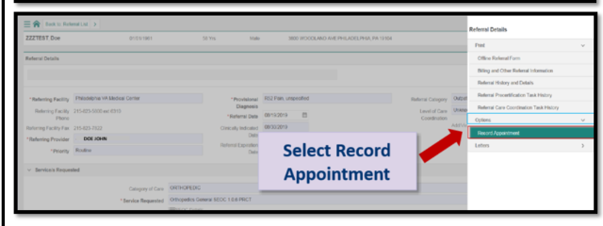
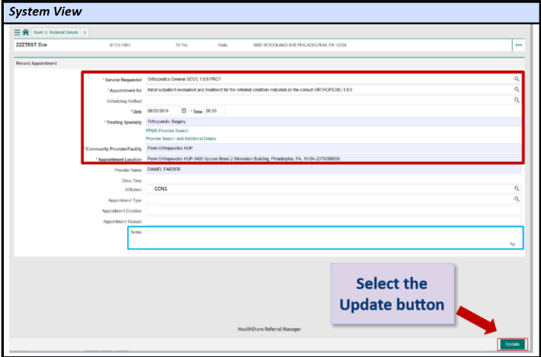
Now it’s time to record the appointment in HSRM.
Within the Vertical Components Menu, select Options, and then select Record Appointment.
Once you have completed all required field, select Update in the bottom right corner to save changes.
Notes:
Read Slide

Slide 52
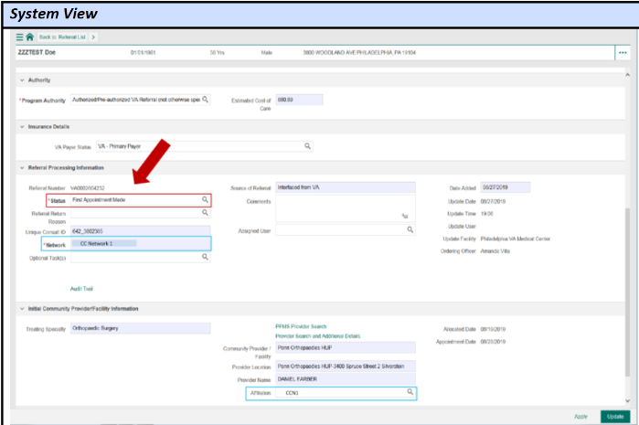
Once the page reloads, verify that the status has changed to First Appointment Made.
Notes:
Read Slide

Slide 53
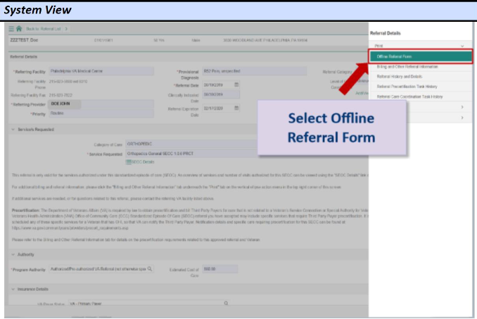
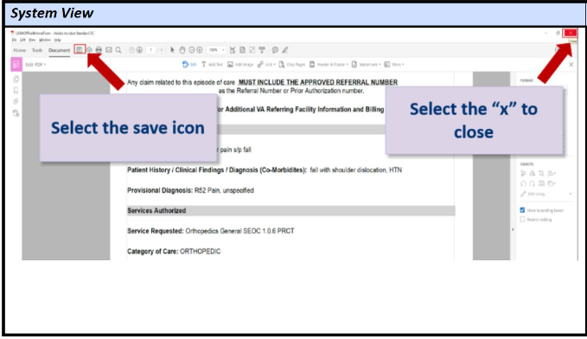
Generating an HSRM Offline Referral Form and RefDoc Package
Lastly, the referral information should be sent to the community provider. Unless a community provider is using HSRM, they will need to receive this information via the Offline Referral Form.
The form will open in Adobe Acrobat and can be printed from there directly. Any updates needed to the Offline Referral form can be made using Adobe Pro.
Notes:
Read Slide

Slide 54
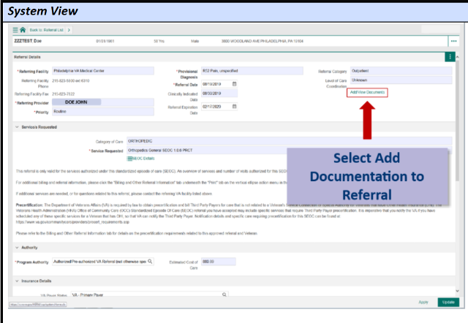
If the provider is not using HSRM, send the REFDOC package along with the Offline referral form.
If the provider is using HSRM, the Request Manager can upload the REFDOC package under the Add/View Documents for the provider to review.
The REFDOC package should include:
Community Care Consult
Required Medical Documentation
Veteran’s Demographics
Notes:
Read Slide

Slide 55

Conclusion
You have successfully scheduled your Community Care VAOS Appointment Request.
To process another request, navigate back to the Community Care que in Scheduling Manager.
Notes:
You have successfully scheduled your Community Care VAOS Appointment. To process another request, navigate back to the Community Care que in Scheduling Manager.

Slide 56
CC VAOS and SM Resources
Key Documents are located here:
CI Solutions Page
Community Care Hub
Office of Community Care Field Guidebook
Connected Care VAOS SharePoint
If you have any questions, contact:
Business issues: CCVAOSSupport@va.gov
Technical issues: VAR_Release_Team@va.gov
Notes:
For further details and information on Community Care for VAOS, please visit our SharePoint site listed within the CI Solutions Page where you will find SOPs, training documents, and other reference material. Youll also find valuable information on the Community Care Hub, Office Of Community Care Field Guidebook, and Connected Care VAOS SharePoint.
If after this training or down the road you have questions, please feel fee to reach out to our VAOS team for business process questions and are technical team for technical issue.

Slide 57
Frequently Asked Questions (FAQs)
When will VAOS for CC appointment requests “go live”?
CC VAOS will be rolled out in a phased approach. Starting August 17, 2020 with the facilities that currently scheduled community care appointments on the behalf of the Veteran, and then August 31st and September 14th to the remaining VISNs. Please see slides 9 and 10 for the detailed list.
All designated Request Managers complete the mandatory training and have access to SM.
The facility’s VistA community care clinics are set up for audiology, nutrition, optometry, podiatry and primary care.
Field Support will work with each facility POC to review and update the Deployment and Implementation Tracker (DIT) business readiness and technical functionality to meet the mandated date.
Field Support notifies the VAOS project team to "activate" CC VAOS at the facility.
Notes:
Read Slide

Slide 58
Frequently Asked Questions (FAQs) Cont’d
Is CC VAOS required at all facilities?
CC VAOS will be required for facilities implementing it for the first time by COB September 30, 2020. Facilities that have previously used CC VAOS to scheduled community Care appointments will be required to use CC VAOS by August 17, 2020.
Were the 11 unions notified?
Yes, VAOS (formerly Veterans Appointment Request) is addressed by the MOU signed by the VA and the AFC-CIO on December 7, 2016.
What are the timing requirements for processing CC VAOS request?
You must initiate processing a CC VAOS request within three (3) business days from submission date.
Appointments should be scheduled within 14 days of the requested date.
What if the one preferred provider is not available?
Request Manager must use VA locator tool to schedule Veteran with an available provider that meets the Veteran’s time preferences and is within reasonable distance of their address.
Notes:
Read Slide

Slide 59
FAQs Cont’d
Are Wait Time Veterans eligible?
No. Veterans are eligible if they meet one of the following:
Live in one of the following states – North Dakota, South Dakota, Montana, Alaska, or Wyoming, due to low Veteran population density
Reside in a U.S. state or territory without a full-service VA Medical Center (Alaska, Hawaii, New Hampshire, and U.S. territories of Guam, American Samoa, Northern Mariana Islands, and the U.S. Virgin Islands)
If the Veteran does not meet new MISSION Act standards but has a “General Best Medical Interest (BMI)” that allows a Veteran to obtain some, or all, of their care in the community as opposed to a BMI which is just for a specific episode of care.
Potential reasons for general best medical interest (hardship) include geographical challenges, environmental factors, a medical condition that impacts the ability to travel, or if a Veteran needs to travel to their nearest VA medical facility by air, boat, or ferry
Have an average drive time to a VA Medical Center (VAMC) of more than 30 minutes for primary care, or more than 60 minutes for audiology, nutrition, optometry, or podiatry care.
Can community care appointments scheduled in SM be cancelled?
No. Veterans may cancel requests in VAOS, before the appointment is created in SM. Once the appointment has been scheduled in SM, the Veteran must contact the community care provider to cancel/reschedule appointments.
When and where will the recording of this session be available?
It will be posted on the Community Care Hub and distributed to the field in the near future and posted in the Office of Community Care Field Guidebook.
Notes:
Read Slide

Slide 60
Congratulations!! You have completed VAOS CC /SM Training
Certificate of Completion
I ___________________ certify that I have completed the Community Care VA Online Scheduling (CC VAOS) & Scheduling Manager (SM) Training, on __________.(Date)
_________(Signature)

Slide 61
Questions?

